Slide 1
Study Outline
Purpose
Method
Determine the effectiveness of LP UVCI data in detecting UV-absorbing aerosols
Utilize LP to estimate vertical distribution of such UV-absorbing aerosols
Compare plots of elevated UVCI from NM with UVCI plots from LP
Examine retrieved aerosol profiles of events with elevated UVCI using LP radiance data

Slide 2
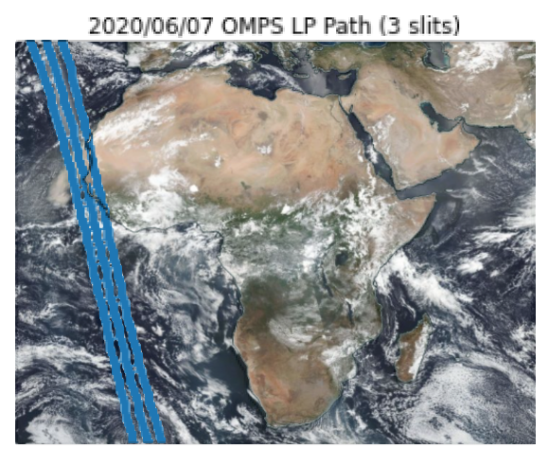
Orbit 44623
June 7, 2020

Slide 3
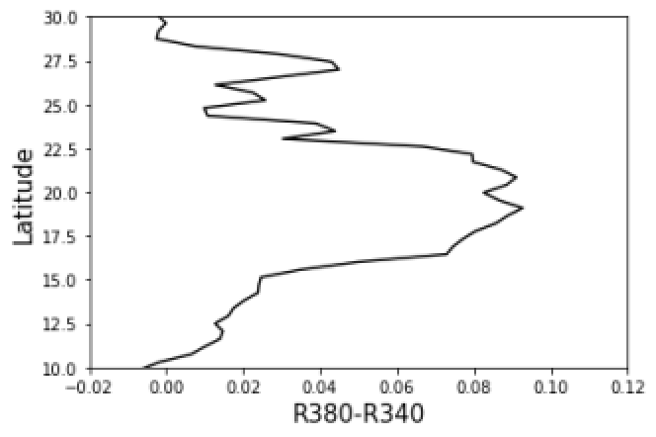
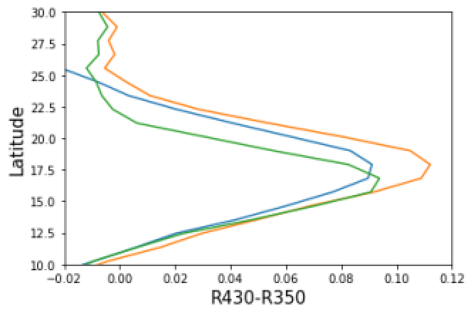
NM and LP UVCI from SNPP: Saharan Dust
OMPS NM row 18
OMPS LP all slits
Center Left
Right

Slide 4
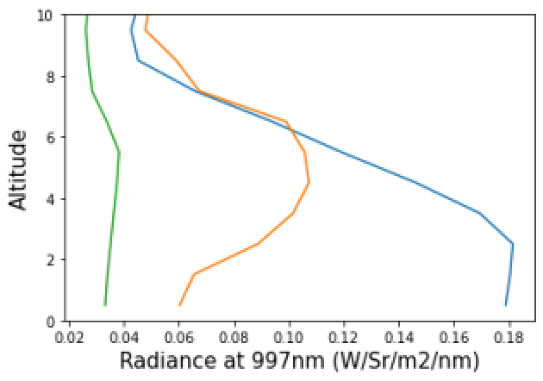
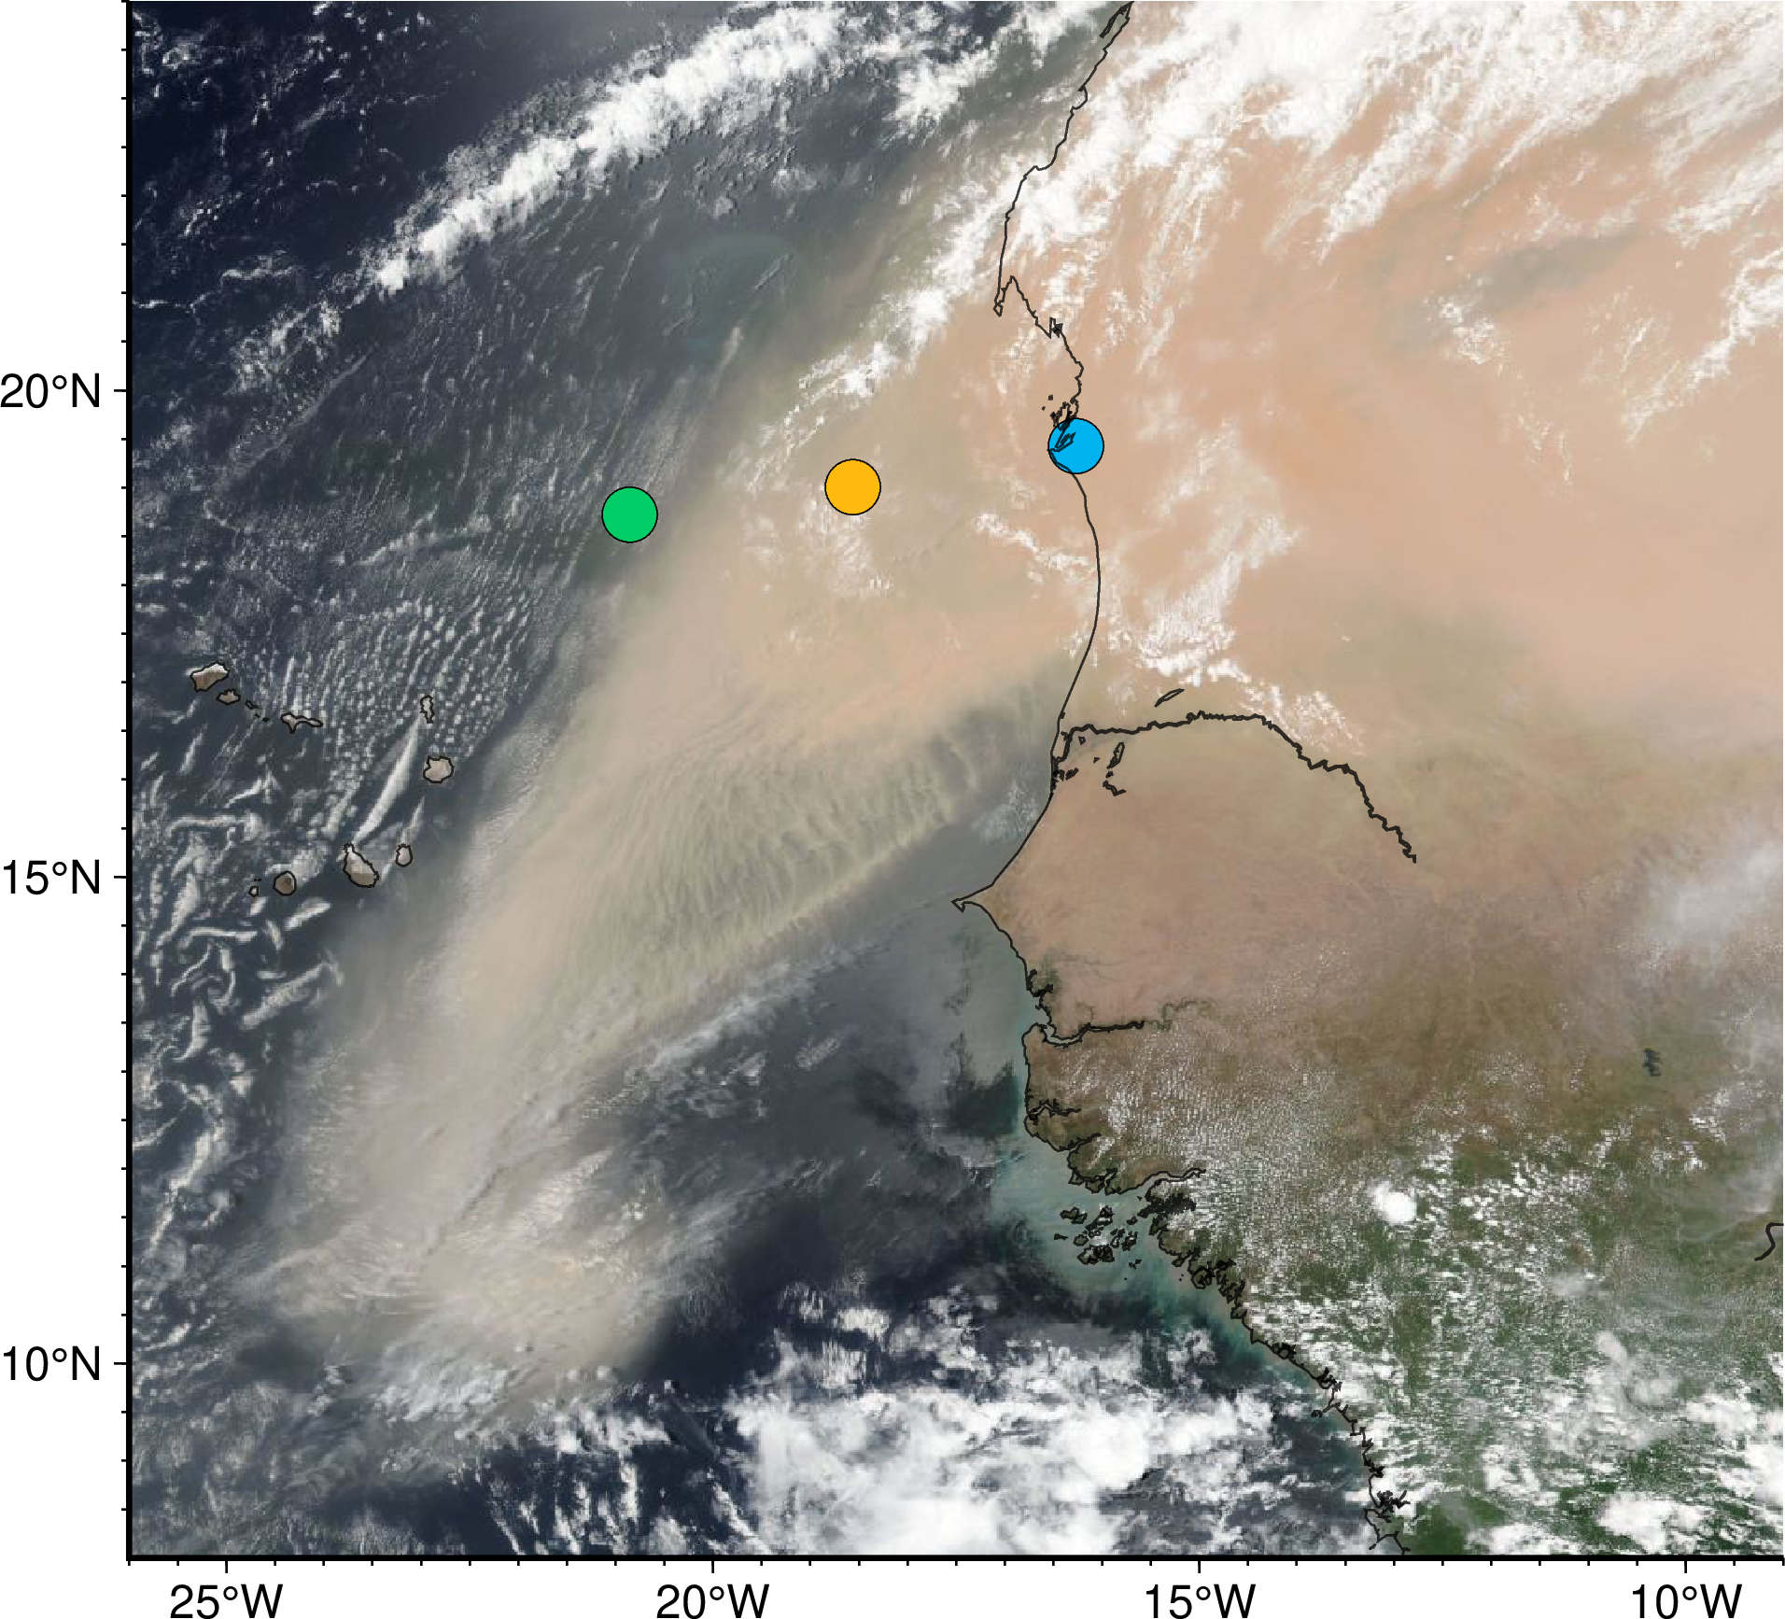
Vertical Profiling of Aerosol using LP 997 nm Radiances: Saharan Dust
Left
Right
Center slit
Rayleigh scattering gets large at shorter wavelengths
997nm radiance gives tropospheric aerosol profile information
Remains harder to see aerosols at lowest altitudes

Slide 5
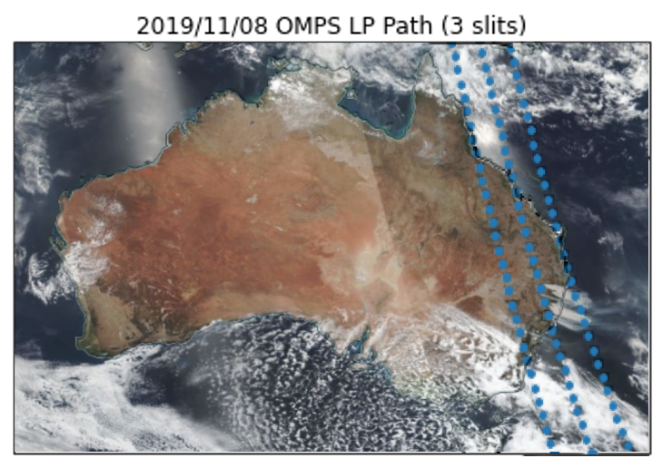
Orbit 41609
November 8, 2019

Slide 6
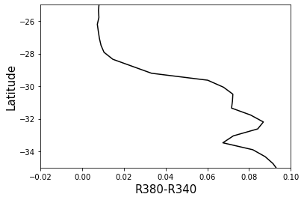
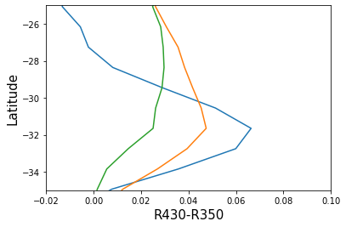
NM and LP UVCI from SNPP: Australian Wildfires
OMPS NM UVCI row 18
OMPS LP UVCI all slits
Right
Left
Center

Slide 7
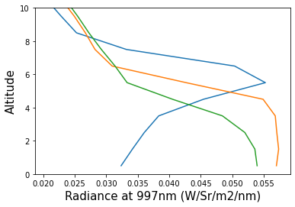
Vertical Profiling of Aerosol using LP 997 nm Radiances: Australian Wildfires
Left
Center
Right

Slide 8
Results and Conclusions
LP UVCI is correlated with NM UVCI and can be used to identify tropospheric aerosols.
LP 997 nm radiances are sensitive to aerosols below 10km.
LP can provide vertical profile information about the aerosols which Nadir instruments cannot.

Slide 9
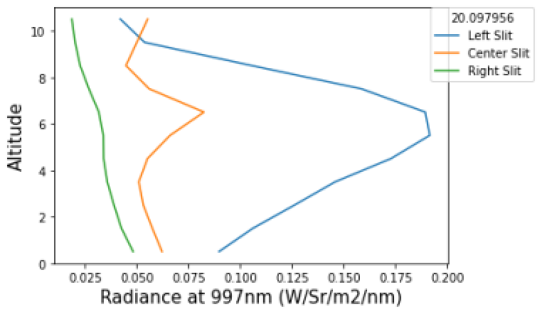
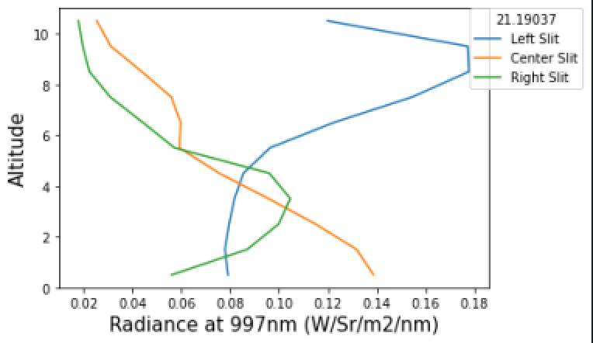
Backup
20 N
21 N

